Slide 1
ECONOMETRICS III: Seminar II
Paper: Comparison and contrast of push and pull motivational effects on trip behaviour: An application of a multinomial logistic regression model. Lee et al (2002)

Slide 2
Topic of the paper
Objective: investigate how individual tourist motivation influences destination choice and vacation activities.
Compare between the push and pull motives in terms of the influence on destination choice and vacation activity of German pleasure travellers to the US, Canada and Asia.
Methodology: multinomial logistic regression and OLS regression to assess the effect of each motivational factor on destination choice and vacation activity participation.

Slide 3
Motivation of the paper
International tourism is an important force in global economy.
Advanced information technology has produced consumers with sophisticated tastes that are able to shop intelligently.
Tourists are better educated and wealthier than ever before. Therefore they have more product information and choices (more bargaining power).
From marketers’ perspective it is important understand the travellers' motivation, attitude, preferences, beliefs.
German travellers are a nice case of study because they are the highest tourism spenders and they are ranked number one in terms of visitor arrivals at all destinations.

Slide 4
Theoretical framework
Theoretical approach to Motivation to travel. Why?
Motivational Push and Pull Framework:
Consumers are motivated by both:
Push factors: internal to the individual and deal with tourist motivation
Pull factors: external force, related to attributes of a travel destination to attract tourist (package of satisfaction)
Motivational Taxonomy in Leisure Pursuit
Try to identify the need-satisfying properties of leisure activities and settings that lead people into action or participation.
Exist limited empirical studies that use this framework to investigate the relationship in a tourism context.

Slide 5
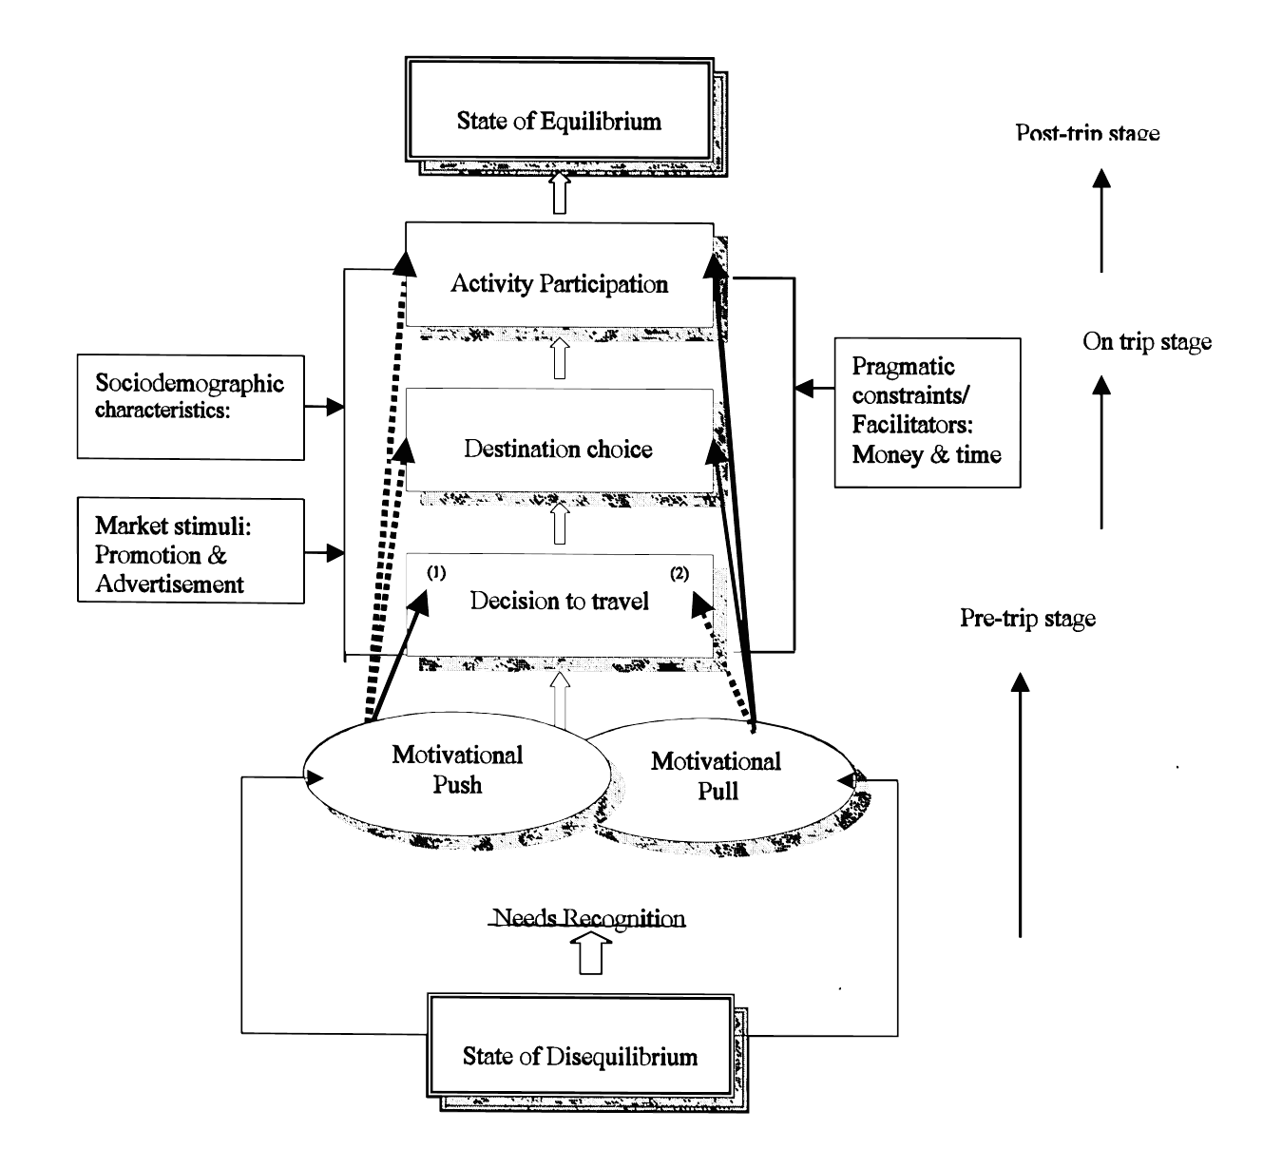
Developing a Conceptual Framework

Slide 6
Data and sample
1996 German Pleasure Travel Market Surveys.
Random probability sampling procedure.
1201 interpersonal in-home interviews to international travellers who were:
>18 years old
Vacation trip of >= 4 nights
by plane outside Europe and the Mediterranean
Trip in the past 3 years or intend to take a trip in the next 2 years.
Questionnaire collect: socio-demographic and behavioural characteristics (travel philosophy, destination image, travel motivation and product preferences)
Final sample: 708 travellers for pleasure to the US, Canada or Asian countries.

Slide 7

Data analysis and variables
1) Multinomial Logistic Regression – Destination choice model:
P_{ij} (Dependent variable) is one of three exclusive destination choices (Canada, the US and Asian countries).
X_{i} are motivation factors and behavioural and personal characteristics.
Odds ratios

Slide 8
Data analysis and variables
2) OLS Regression –Vacation Activity Participation
3 OLS regression models were estimated to test the relationship between motivation and vacation activity participation
Dependent variable: amount of activity participation of 3 distinctive thematic set (cultural, nature/ecological, food+know local people). Interval variable; min 0- max 4 activities.
Independent variables: motivation push and pull factors

Slide 9
Data analysis and variables
Factor Analysis for creating of independent variables
The principle component method for initial factor extraction.
Varimax rotation to determine the final set of factors (in push and pull factors)
Other controls used in both models: length of stay, travel budget, socio-demographic variables (age, gender, education, income and marital status).
From factor analysis: 6 Push factors and 7 Pull factors

Slide 10
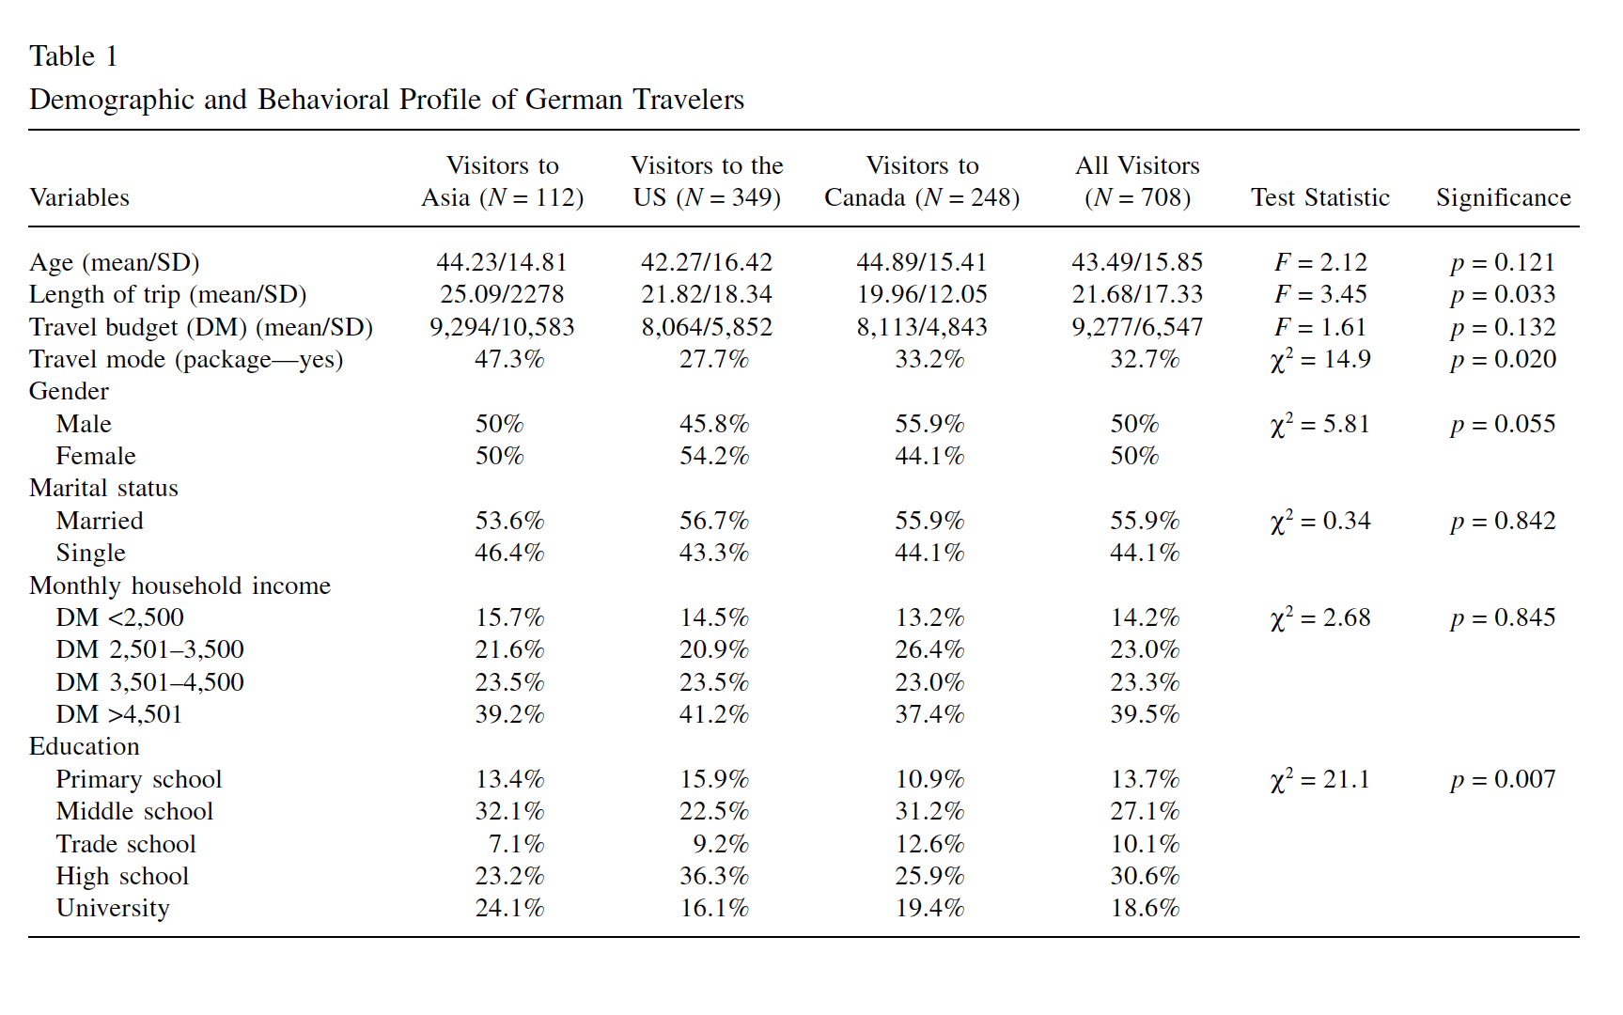
Results. 1) Descriptive

Slide 11
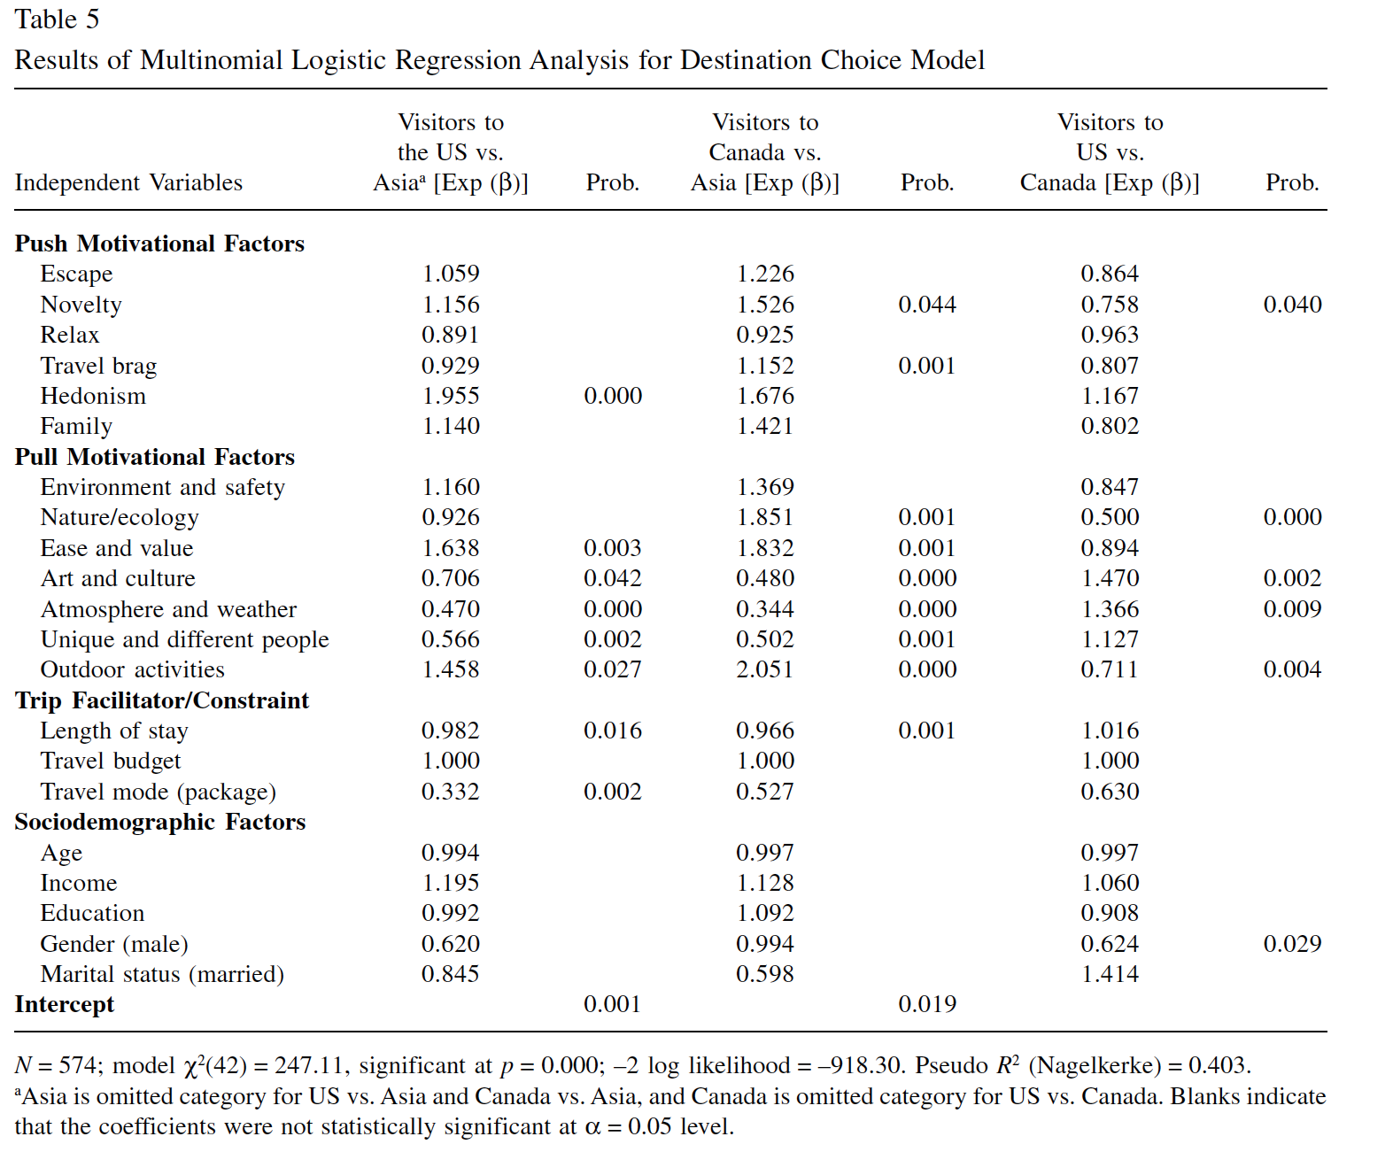
Results. 2) Multinomlog. Destination choice
Pull factors more than Push factors

Slide 12
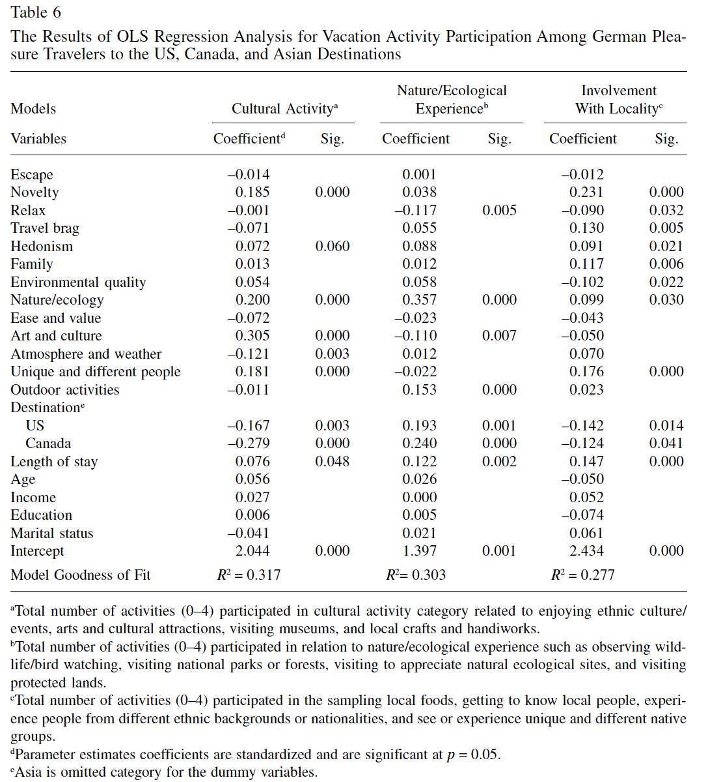
Results. 3) Vacation activity Pursuit

Slide 13
Conclusions
Pull factors based on destination attributes exerted more influence on destination choice than psychological/social push factors.
Different pull factors motivated travellers to select different destinations.
Motivational factors (push + pull) are the more significant determinants than trip length, budget and socio-demographic characteristics.
A typology of vacation activity patterns based on need-satisfying property of motivation may exist.

